Slide 1
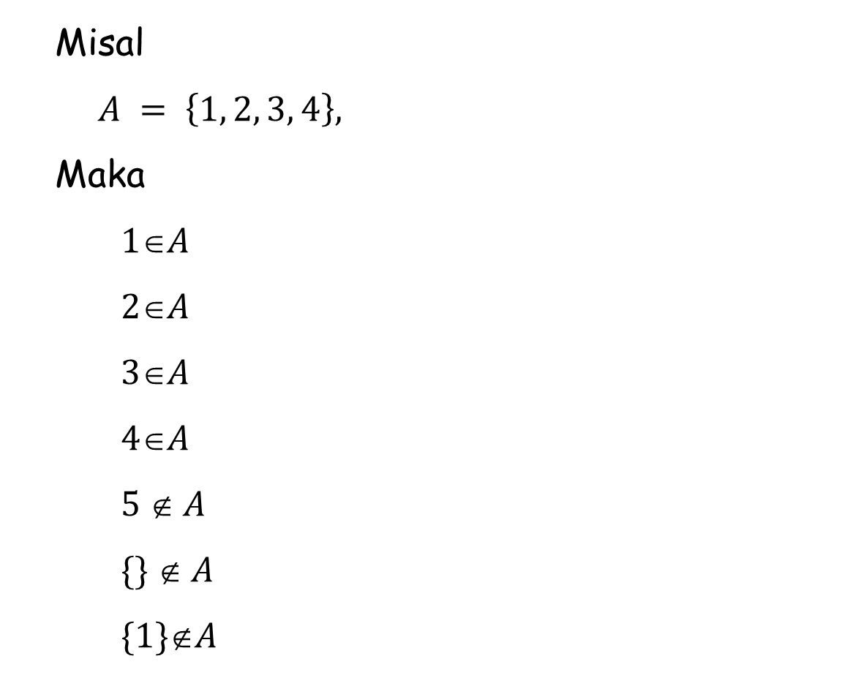
Misal
$$A = \left\{1, 2, 3, 4\right\},$$
Maka
$$1A$$
$$2A$$
$$3A$$
$$4A$$
$$5  A$$
$$\{\}  A$$
$$\{1\}A$$

Slide 2
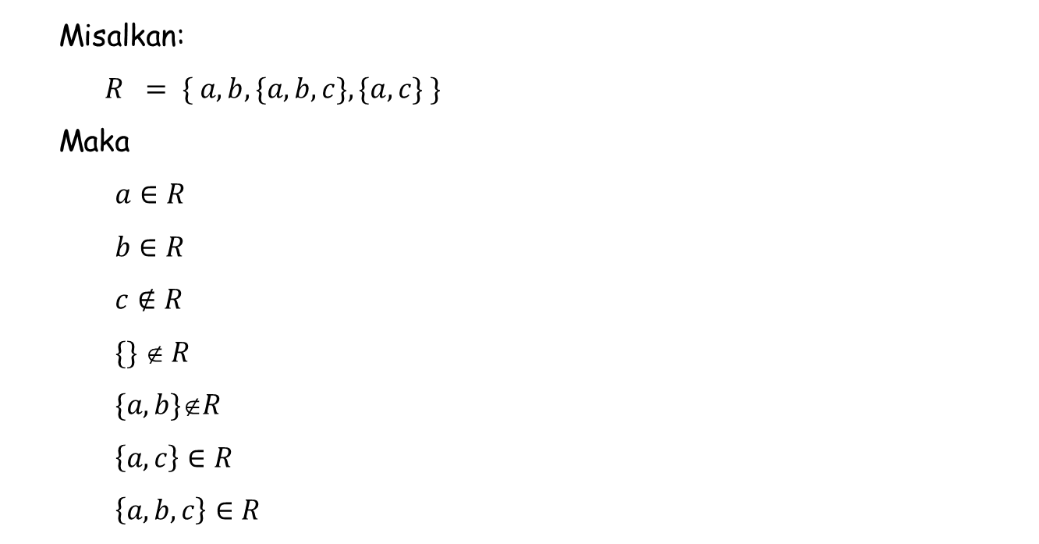
Misalkan:
$$R = \{ a, b, \{a, b, c\}, \{a, c\} \}$$
Maka
$$a∈R$$
$$b∈R$$
$$c∉R$$
$\{\}  R$
$$\{a,b\}R$$
$\left\{a, c\right\}∈R$
$$\left\{a, b, c\right\}∈R$$

Slide 3
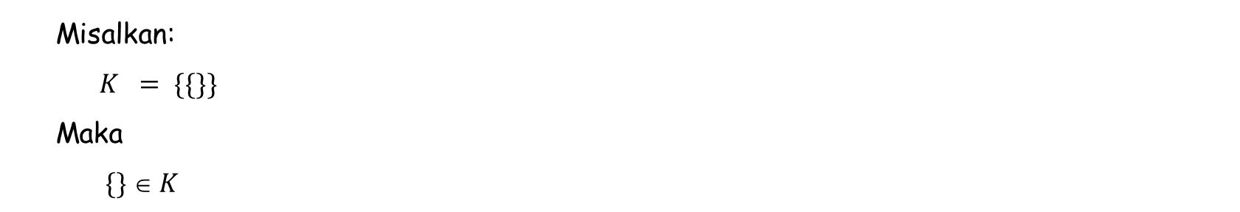
Misalkan:
$$K = \{\{\}\}$$
Maka
$$\{\}  K$$

Slide 4
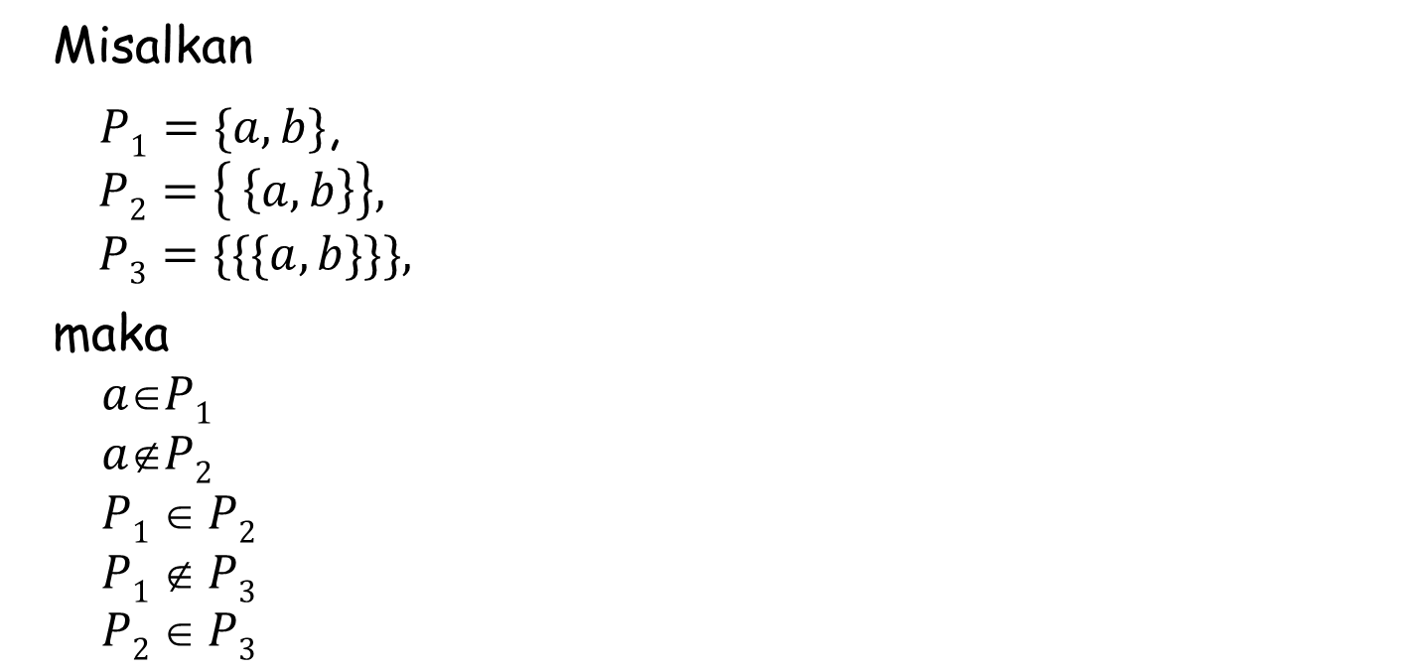
Misalkan
$P1=\{a, b\}$,
$$P2=\left\{ \left\{a, b\right\}\right\},$$
$$P3=\{\{\{a, b\}\}\},$$
maka
$$aP1$$
$$aP2$$
$$P1  P2$$
$$P1  P3$$
$P2  P3$

